Slide 1
ARCADA SUMMARY
John Wickström
Arcada University, August 2024

Slide 2
DATA PROCESSING

Slide 3
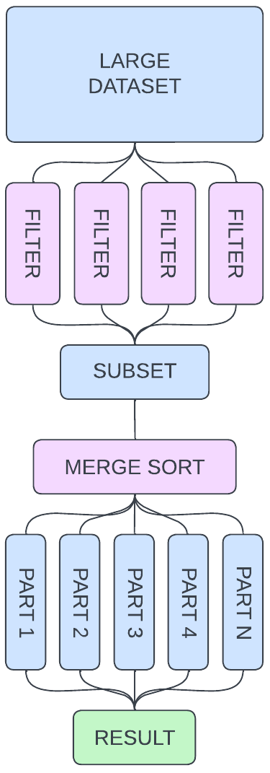
DATA PROCESSING PIPELINES
OPERATIONS
Pipeline operations are surprisingly simple
Identical operations which are applied on an arbitrary amount of rows.
Filtering.
Sorting.
Counting.
Transforming.
Joining.
Grouping.
Reducing.
Aggregating.
Many simple operations are chained together to form complex pipelines
The output of the former operation is the input to the latter..
Each operation is independent from the others.
Receive input, produce output.
Can be scaled infinitely through simple replication.

Slide 4
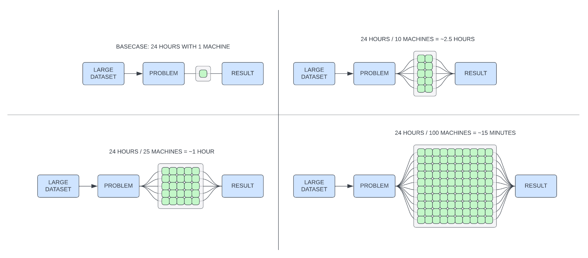
DATA PROCESSING PIPELINES
INFINITE HORIZONTAL SCALING

Slide 5
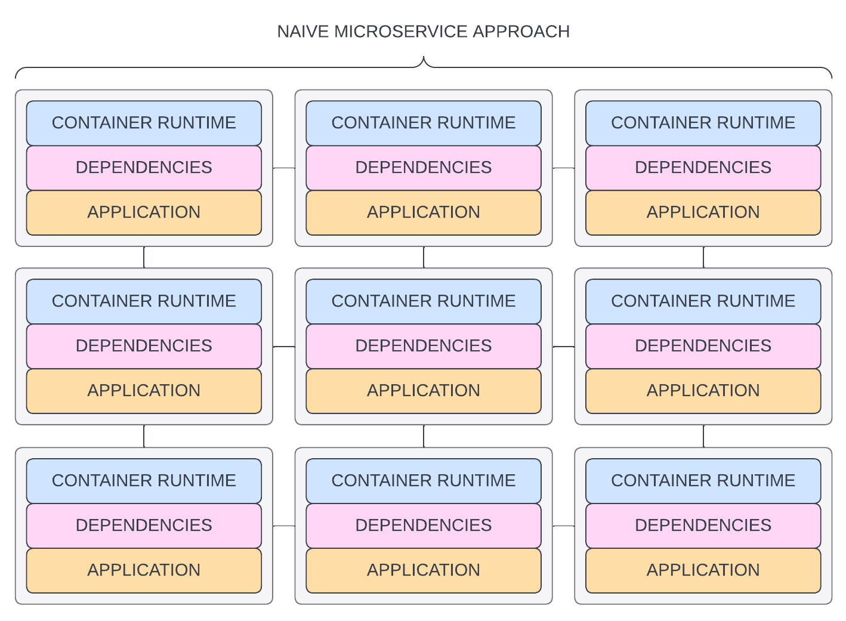
DATA PROCESSING PIPELINES
NAIVE MICROSERVICE IMPL.
Platform agnostic design:
Numeric computation: C++
Machine learning: Python
Database management: Java
Self-contained services:
Breaking one service does not contaminate the others.
Allows to optimize system exactly where it needs it.
Has some glaring problems at scale:
Massive overhead
Large docker environments containers.
Massive dependency duplication for “small” tasks.
Moving data across services increases latency.

Slide 6
PROCESSING ENGINES

Slide 7
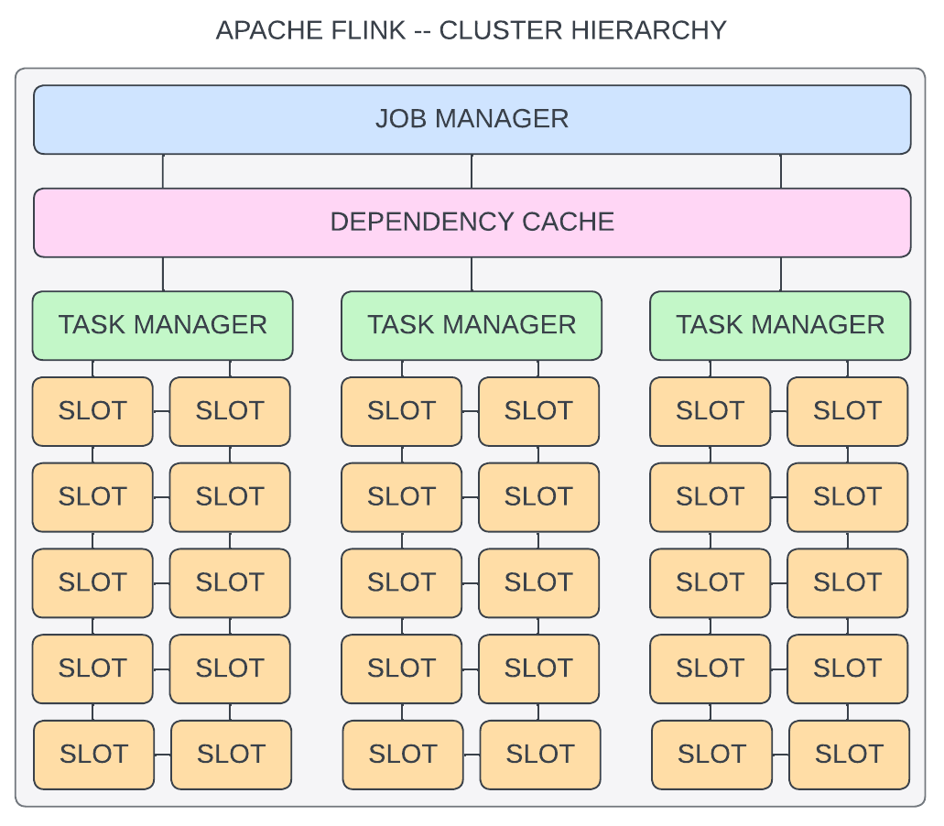
DATA PROCESSING PIPELINES
PROCESSING ENGINES
All computation occurs inside the engine.
All operations share a dependency cache.
Many alternatives:
Apache Spark: Old Code & console
Apache Flink: Modern Code & GUI
Apache Druid: New Point and click GUI
Apache Flink:
Hierarchy:
Job Manager: Coordinating entity
Task Managers: Executing entities
Task Slots: Pipeline Operations
Jobs are submitted to the Job Manager.
Tasks are distributed to the Task Managers.

Slide 8
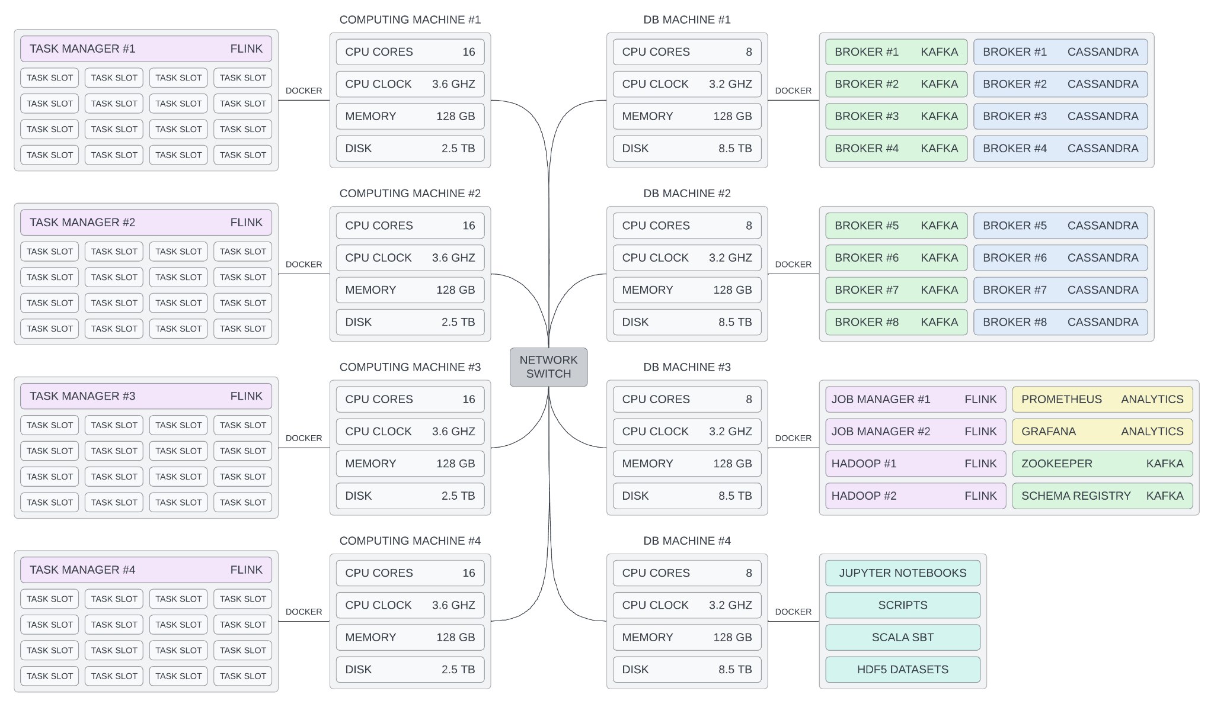
DATA PROCESSING PIPELINES
THESIS INFRASTRUCTURE

Slide 9
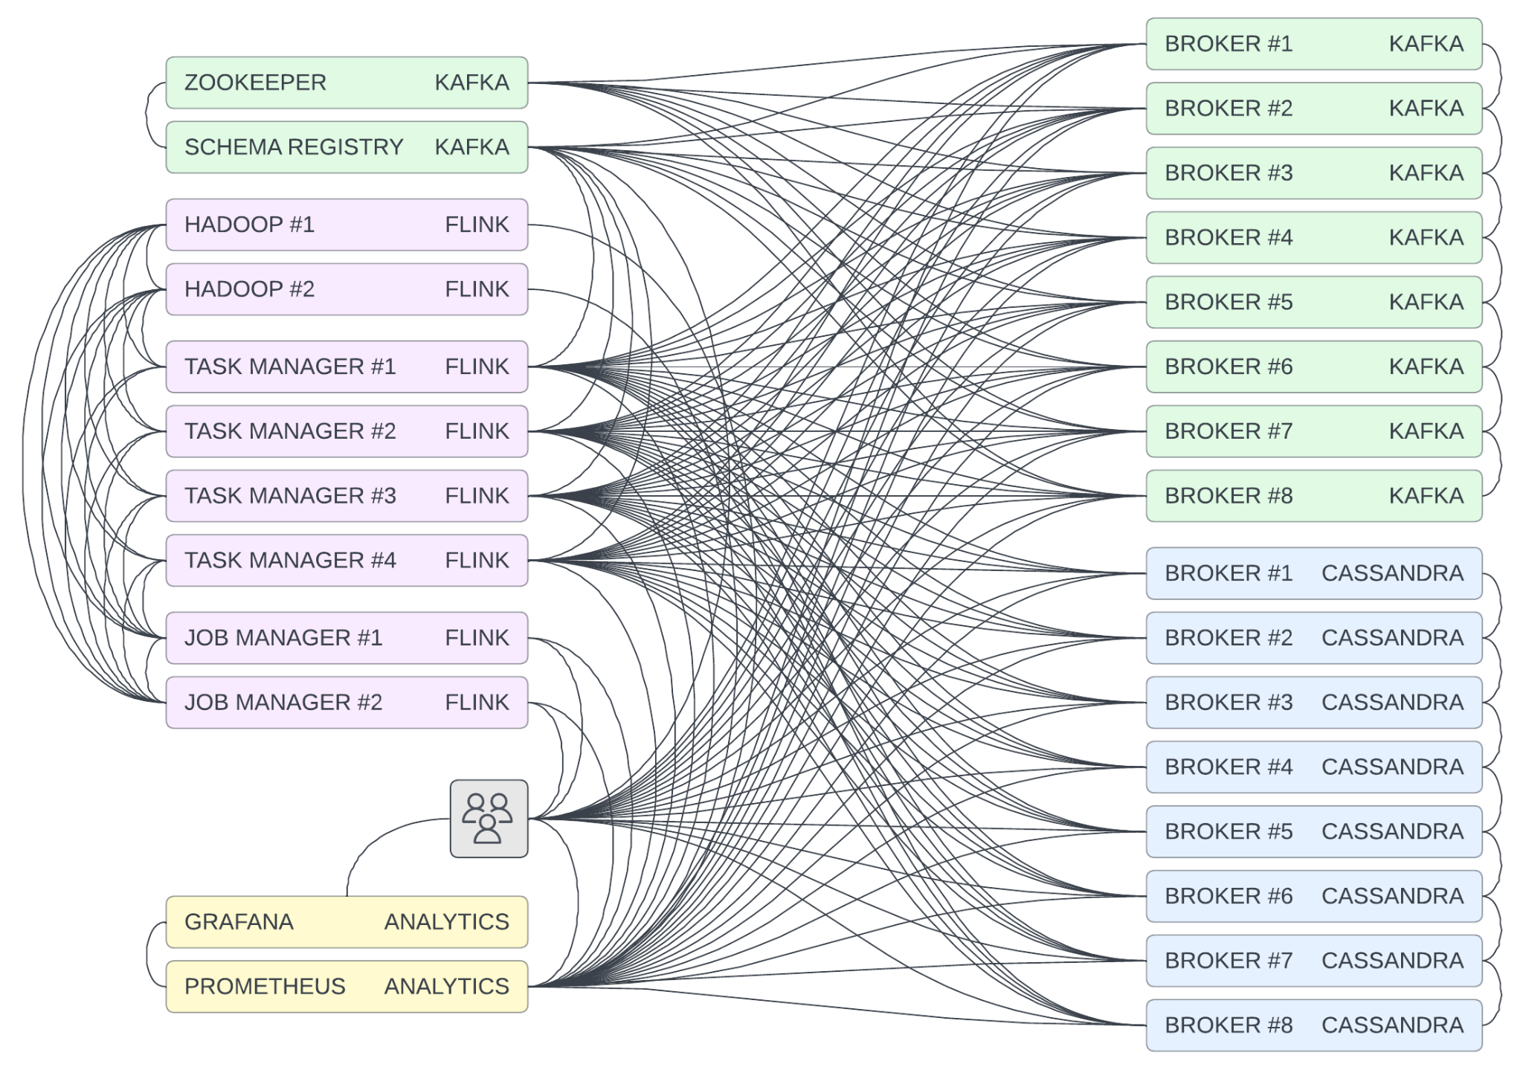
DATA PROCESSING PIPELINES
THESIS INFRASTRUCTURE

Slide 10
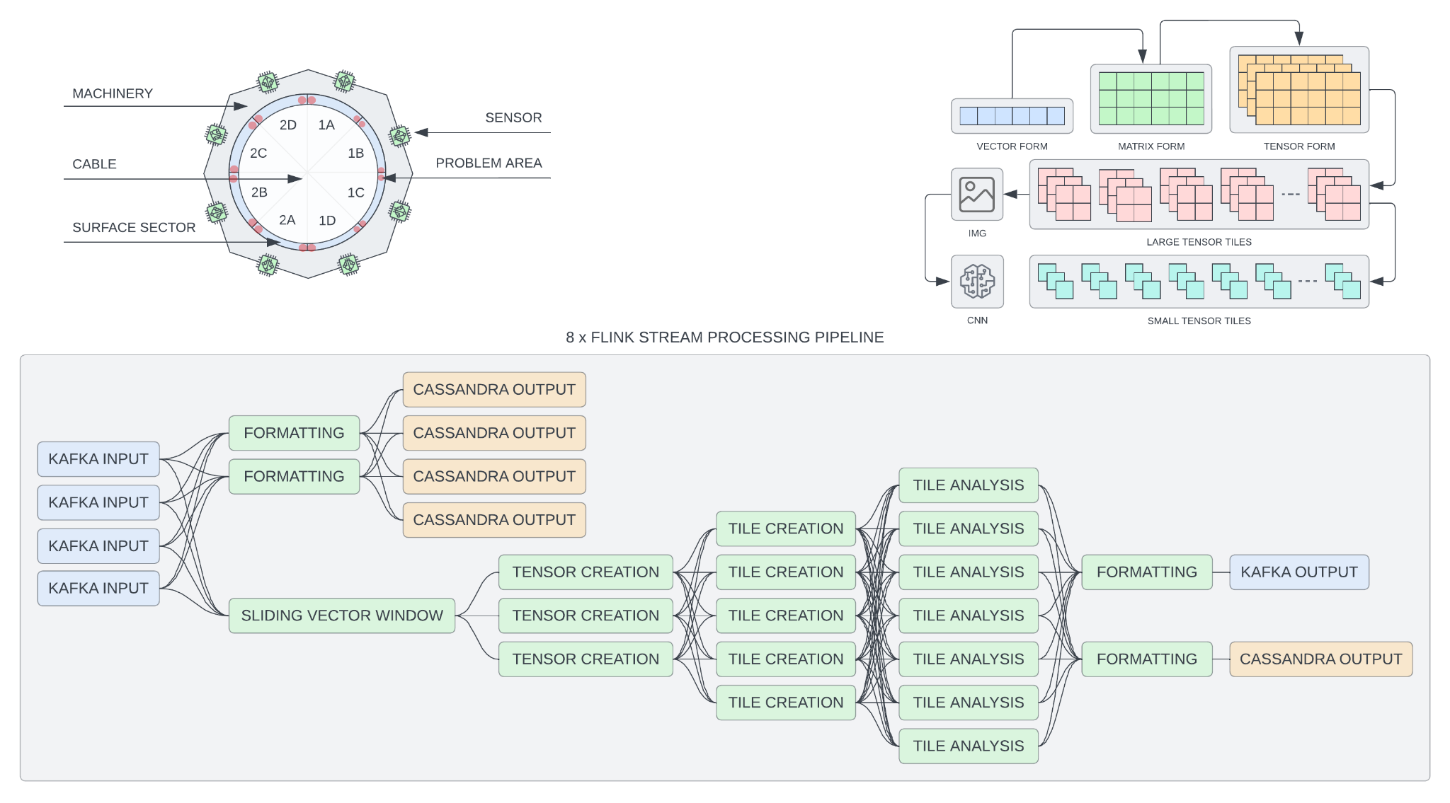
DATA PROCESSING PIPELINES
THESIS PROJECT

Slide 11
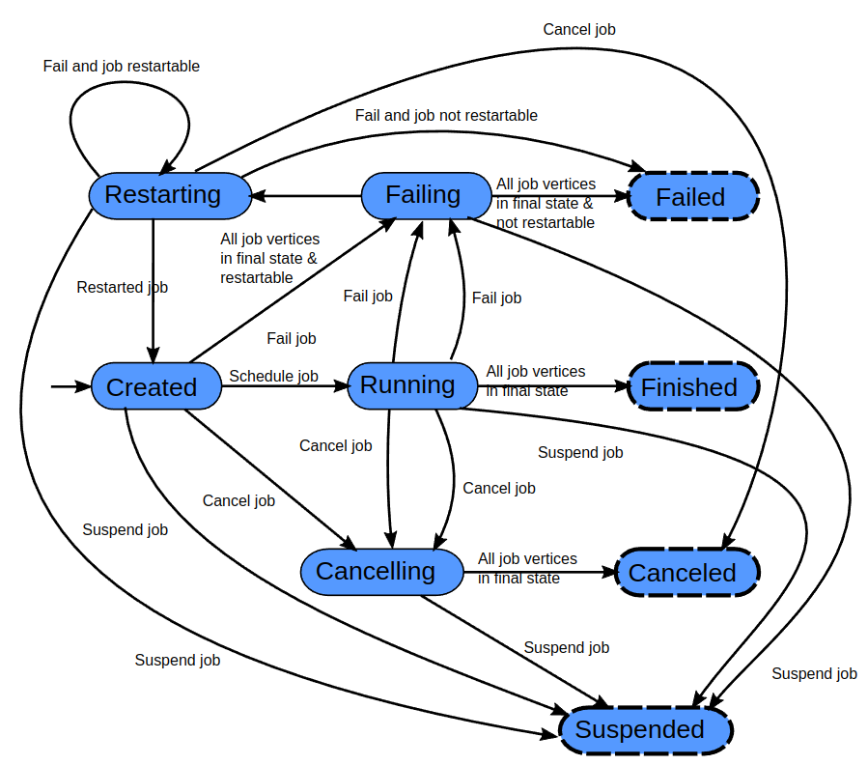
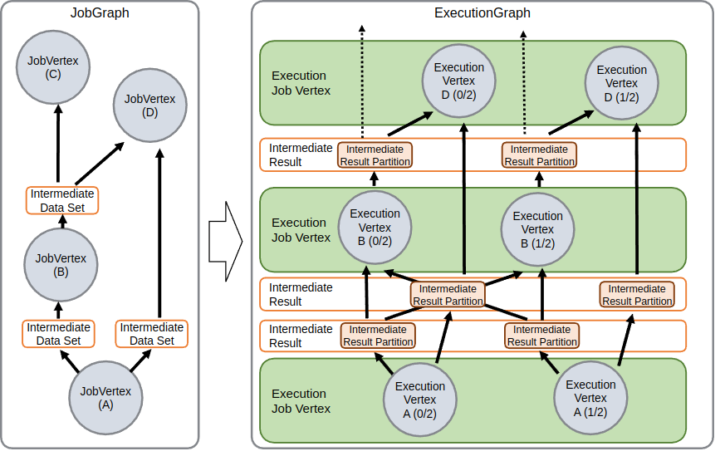
DATA PROCESSING PIPELINES
FLINK TASK LIFECYCLE

Slide 12
PIPELINE OPTIMIZATION

Slide 13
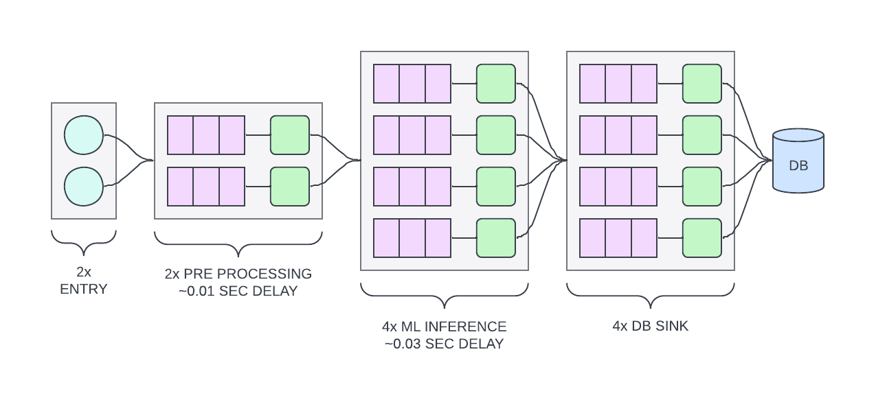
PIPELINE OPTIMIZATION
BASECASE
All pipeline stages have been fully declared in code.
Now we want to optimize the degree of parallelism:

Slide 14
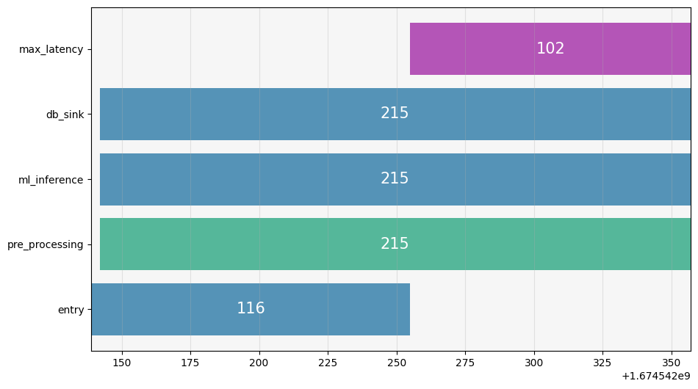
PIPELINE OPTIMIZATION
PRE-PROCESSING LAYER

Slide 15
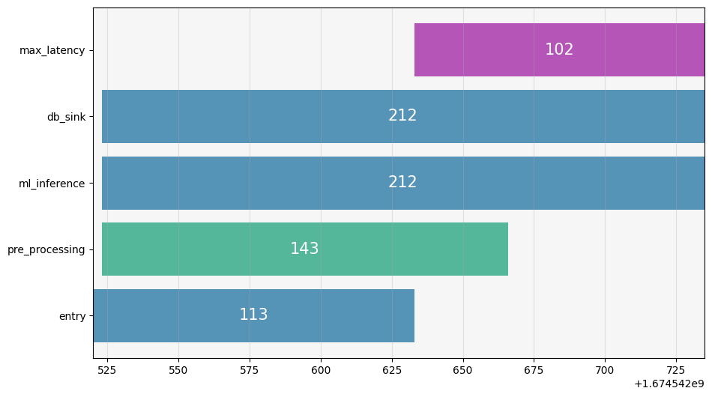
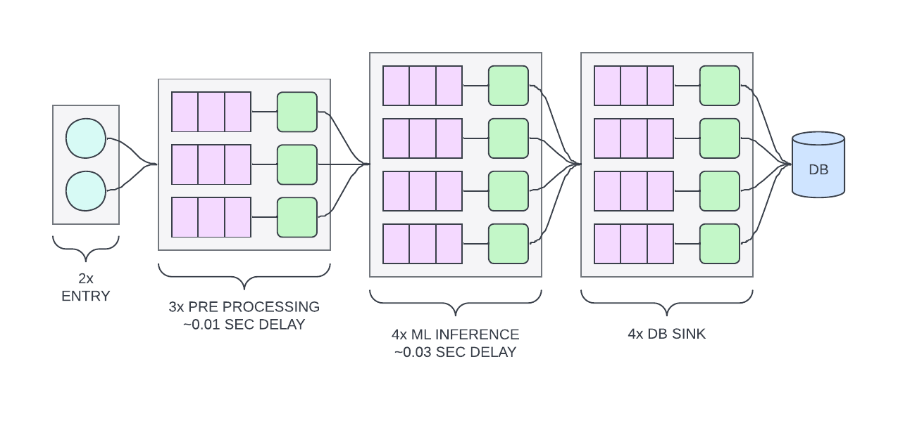
PIPELINE OPTIMIZATION
PRE-PROCESSING LAYER
215 => 143 (-33%)

Slide 16
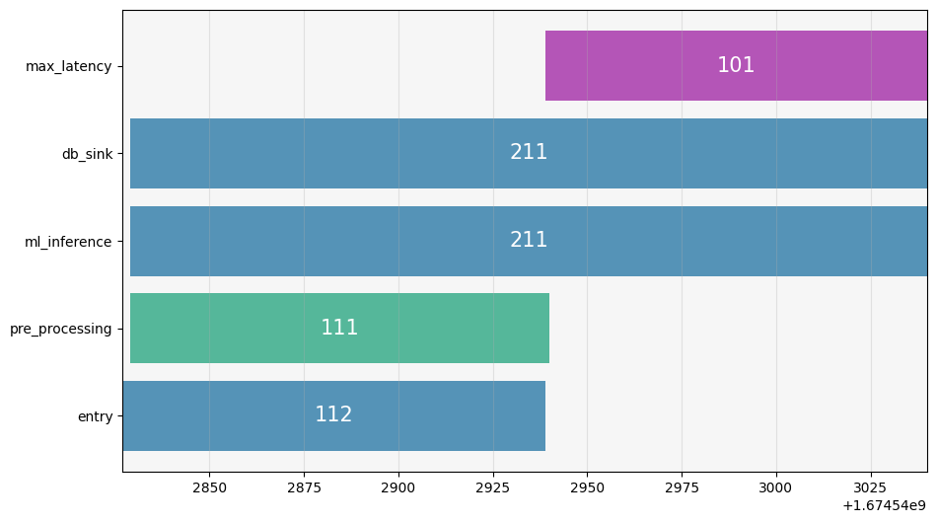
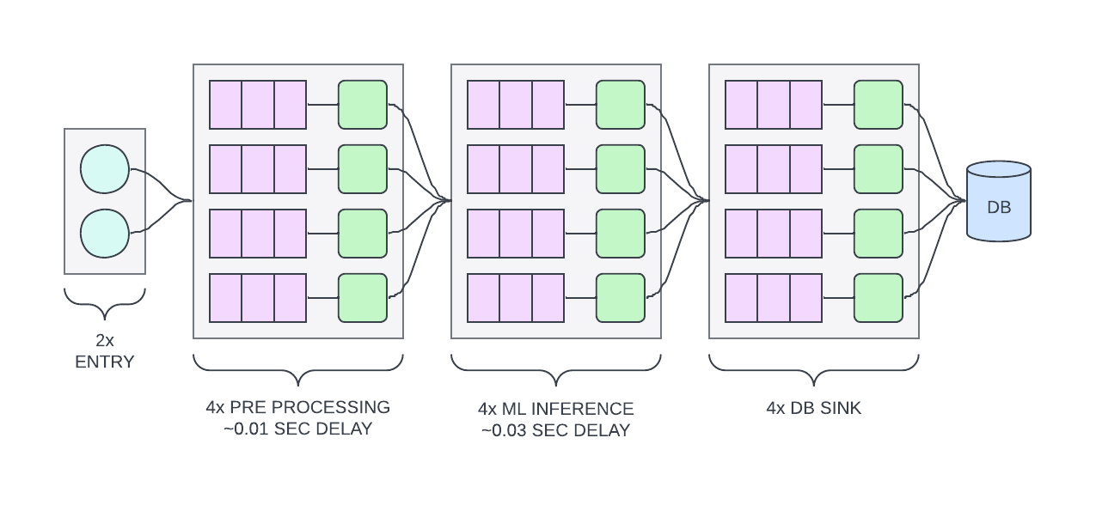
PIPELINE OPTIMIZATION
PRE-PROCESSING LAYER
143 => 111 (-22%)

Slide 17
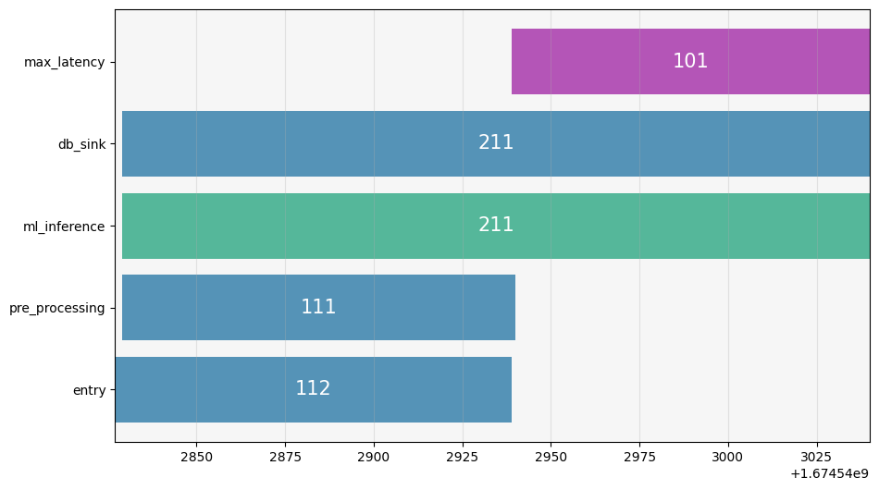
PIPELINE OPTIMIZATION
INFERENCE LAYER

Slide 18
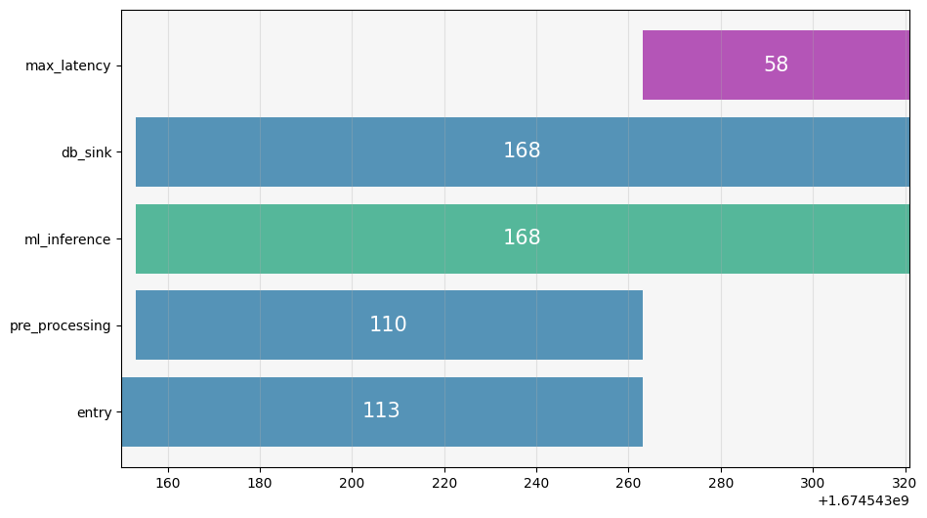
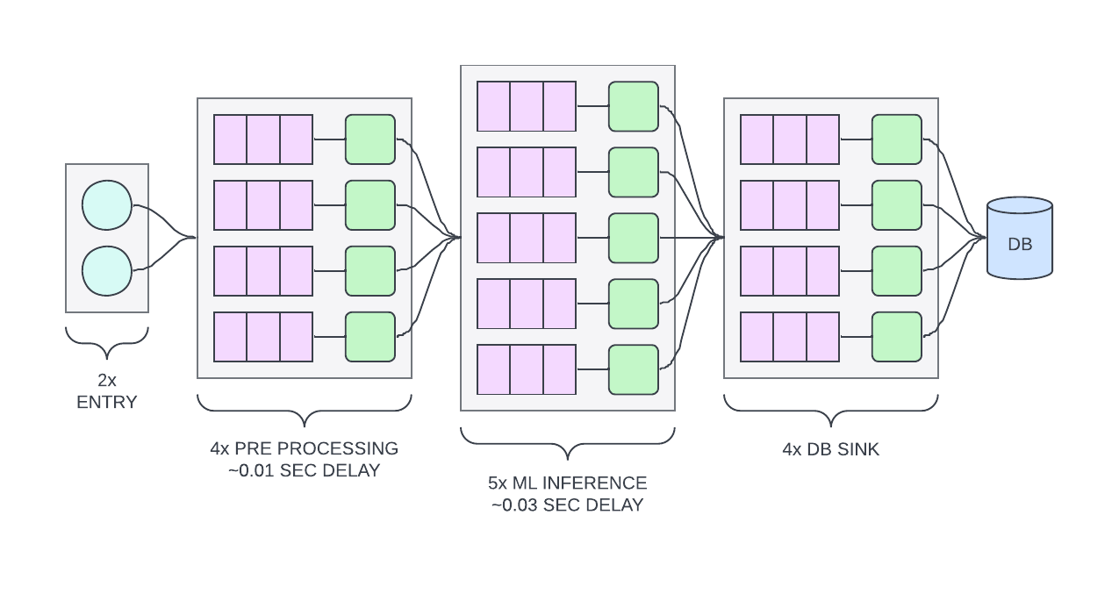
PIPELINE OPTIMIZATION
INFERENCE LAYER
211 => 168 (-20%)

Slide 19
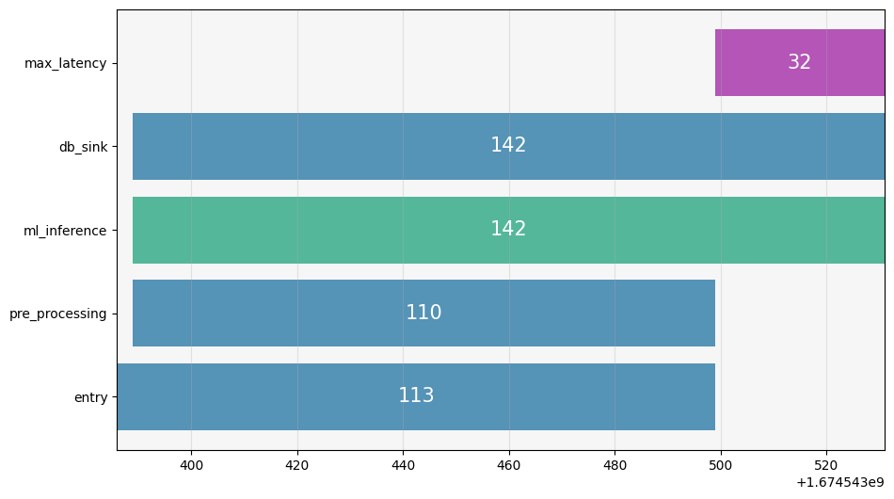
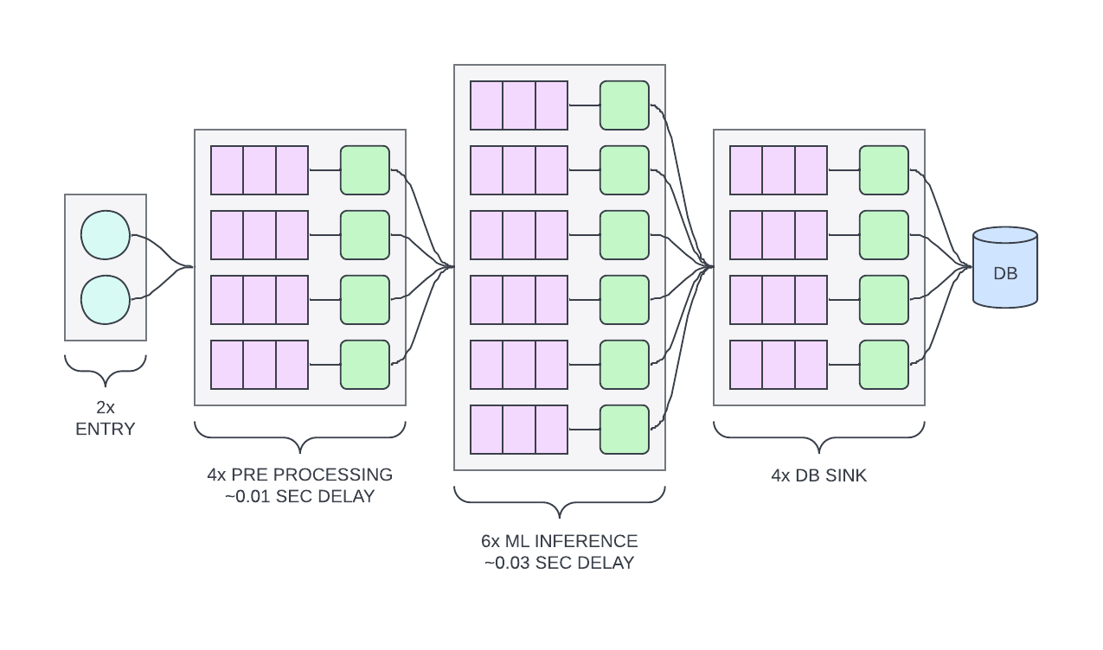
PIPELINE OPTIMIZATION
INFERENCE LAYER
168 => 142 (-15%)

Slide 20
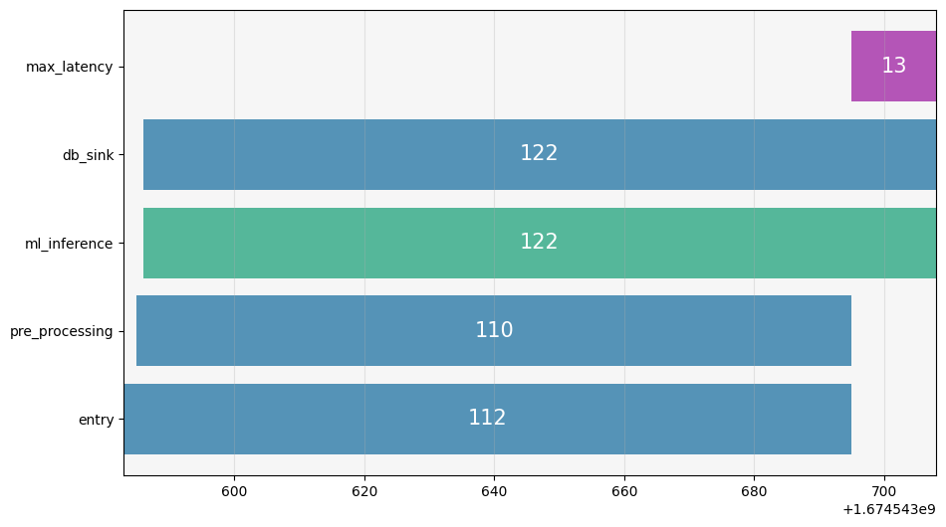
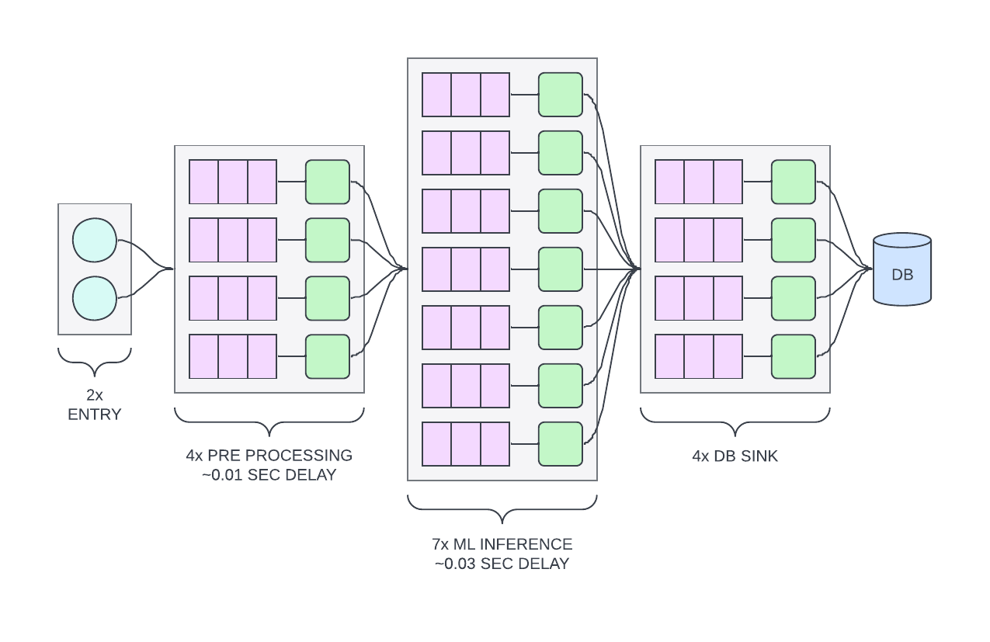
PIPELINE OPTIMIZATION
INFERENCE LAYER
142 => 122 (-14%)

Slide 21
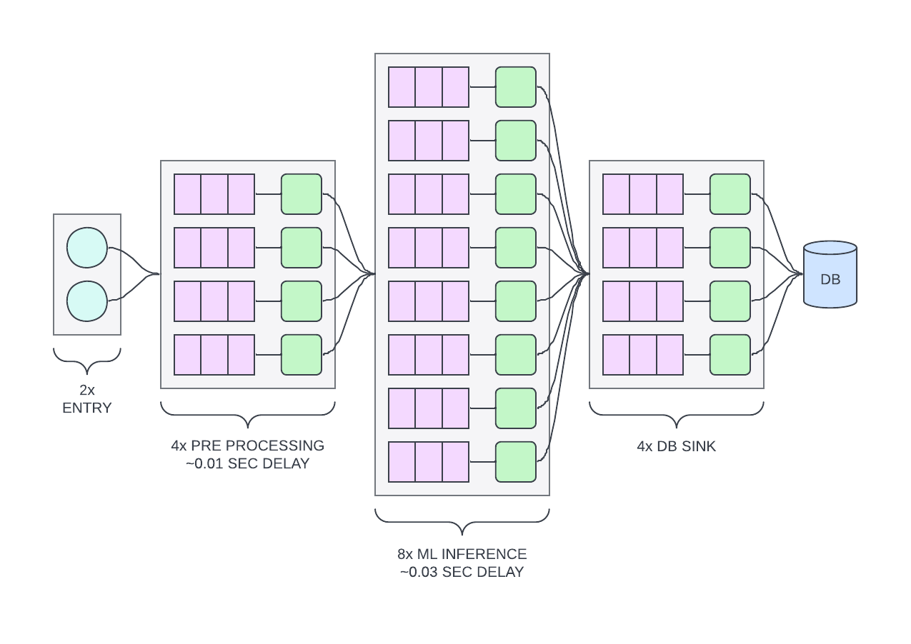
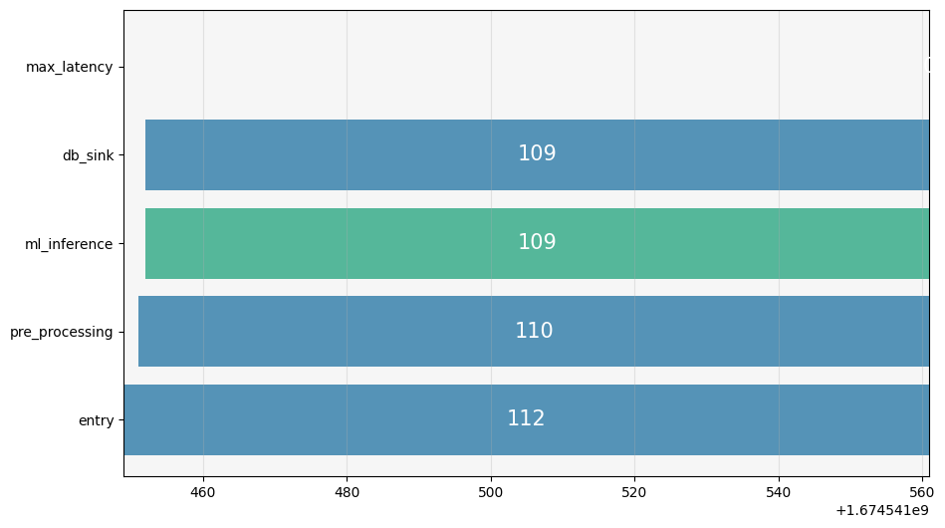
PIPELINE OPTIMIZATION
INFERENCE LAYER
122 => 109 (-10%)

Slide 22
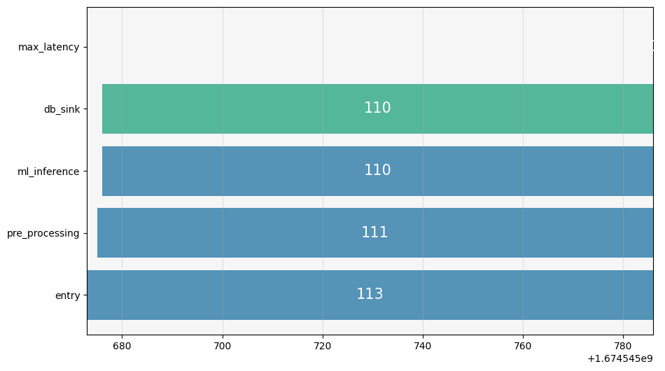
PIPELINE OPTIMIZATION
DB LAYER

Slide 23
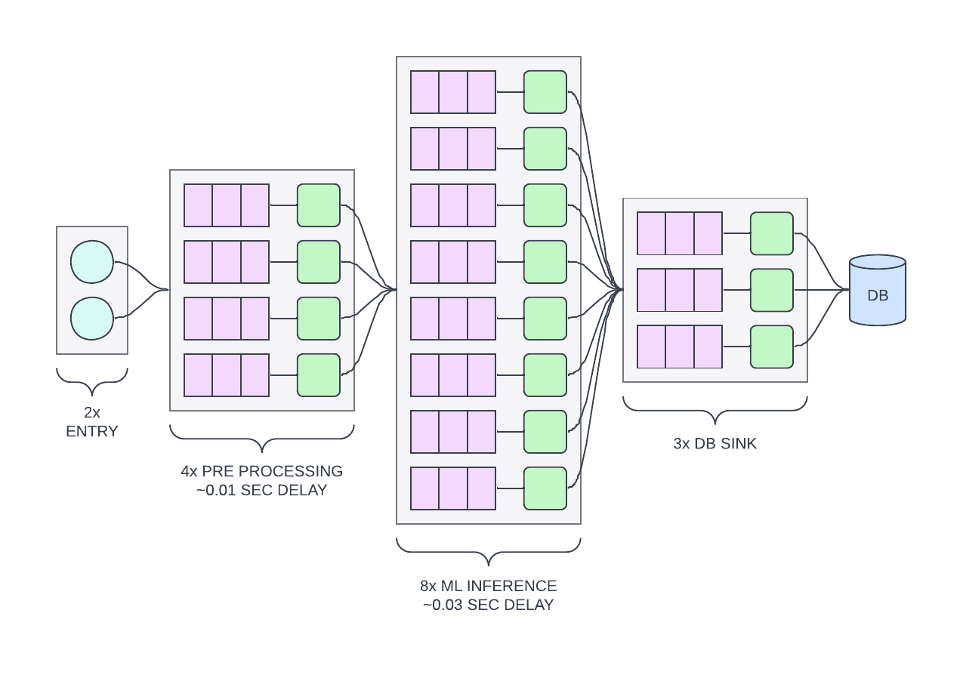
PIPELINE OPTIMIZATION
DB LAYER
110 => 110 (0%)

Slide 24
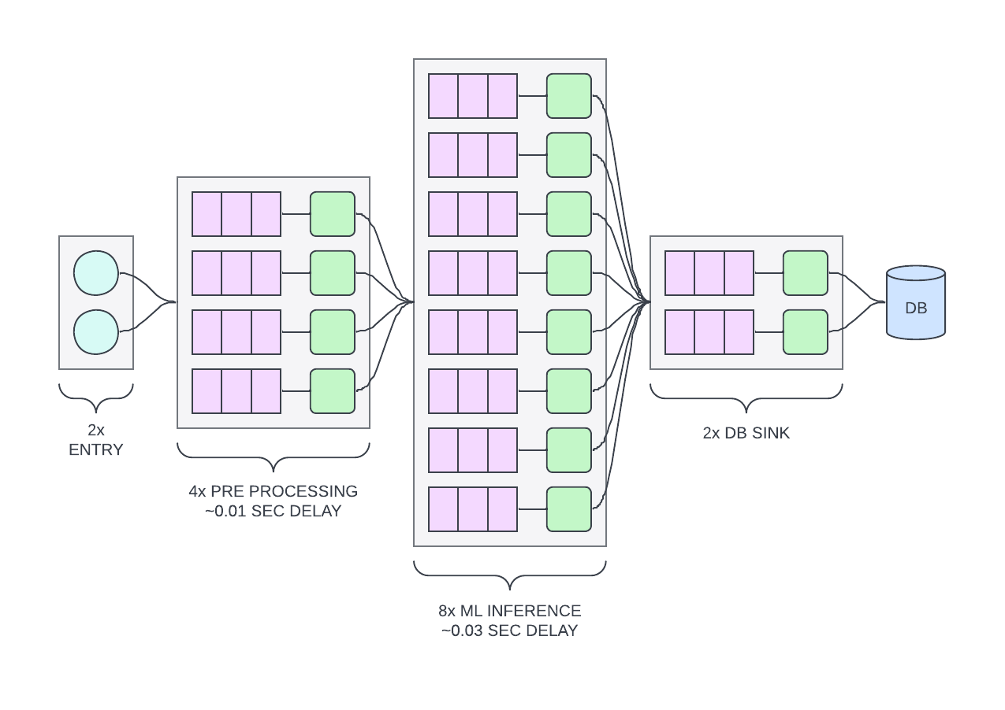
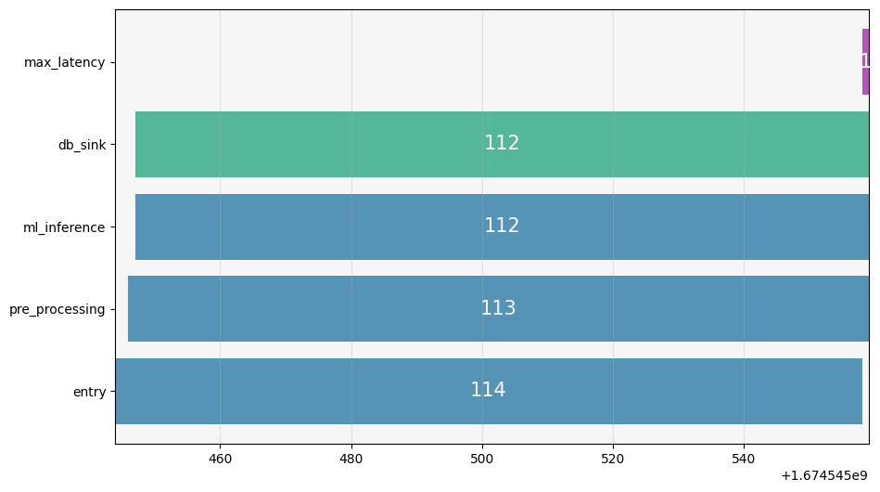
PIPELINE OPTIMIZATION
DB LAYER
110 => 112 (+2%)

Slide 25
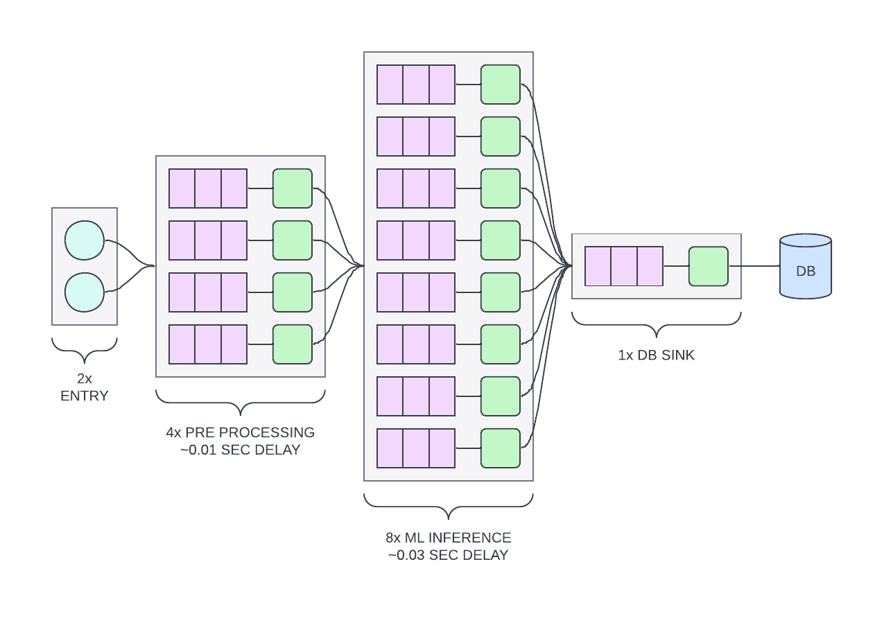
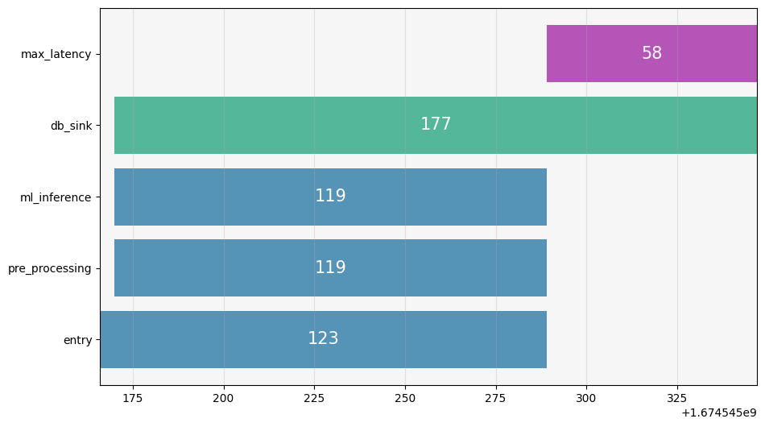
PIPELINE OPTIMIZATION
DB LAYER
112 => 177 (+37%)

Slide 26
PIPELINE OPTIMIZATION
DB LAYER

Slide 27
PIPELINE OPTIMIZATION
SCALING IN CODE
SHOW PARALLELISM IN CODE

Slide 28
CONTROLLED DATA FEEDING

Slide 29
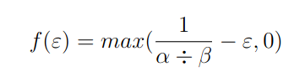
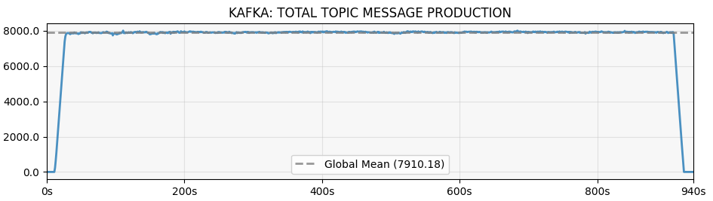
CONTROLLED DATA FEEDING
Perform experiments by simulation real environments
Benchmark systems at different interval breakpoints.
Use real datasets by preloading them into memory.
Use a multi-threaded Scala script that performs n “actions” per second.
Thread action cooldown for steady interval
Alpha = Total steady actions per second.
Beta = Number of threads to use.
Epsilon = Duration of the performed action.
The action changes depending on what system is being tested.
Efficient thread sleeping stops working very quickly
Actively tracking < 1ms cooldowns from an inactive thread is hard.
Scheduler takes over and the script accuracy tanks.
Busy waiting fixes the problem.
Occupies an entire machine for the duration of the experiment.

Slide 30
STREAMING VS. BATCHING

Slide 31
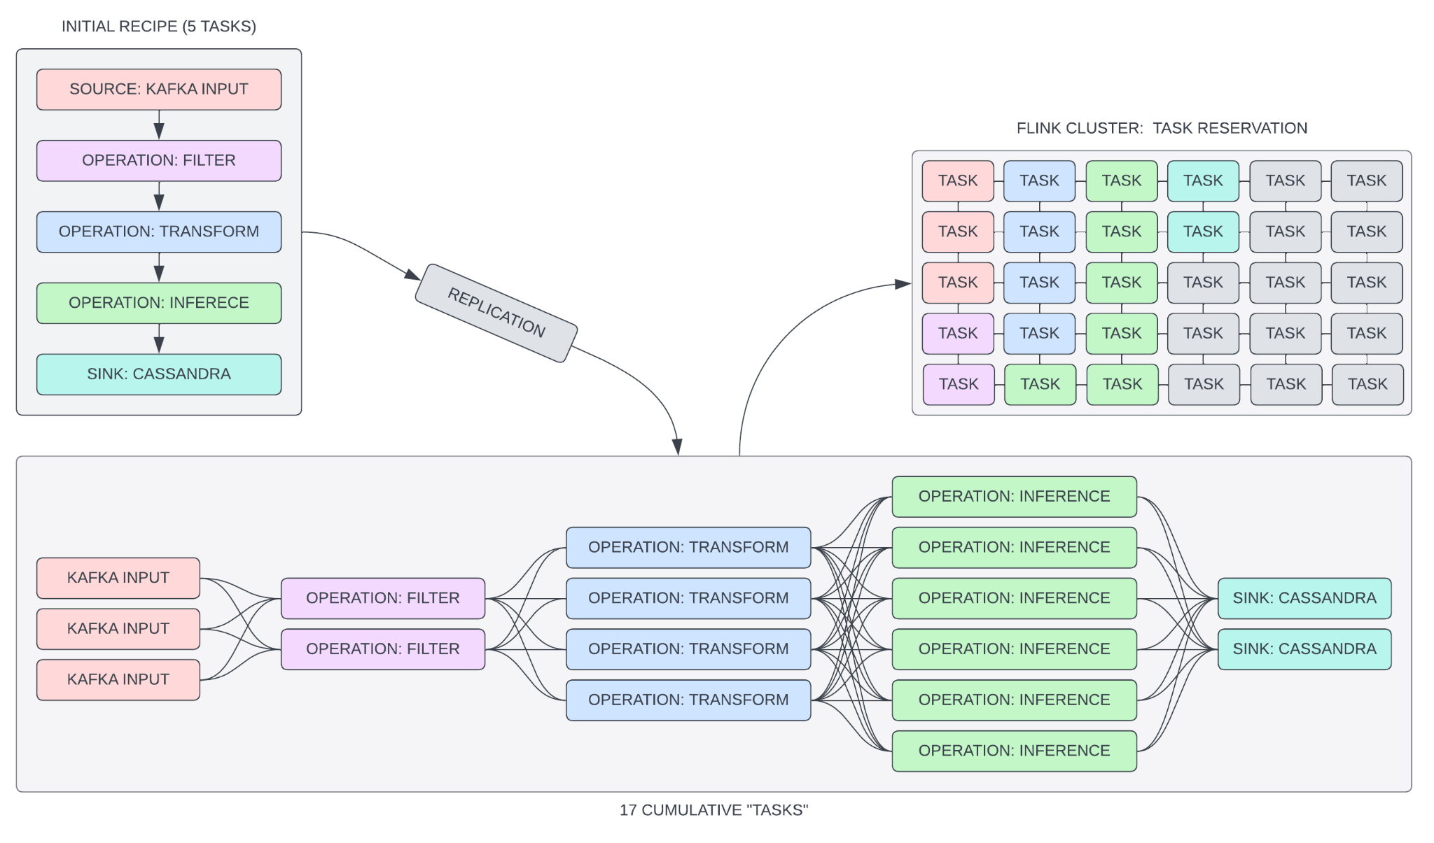
PIPELINE OPTIMIZATION
STREAMING
REQUIRES “ENOUGH” RESOURCES

Slide 32
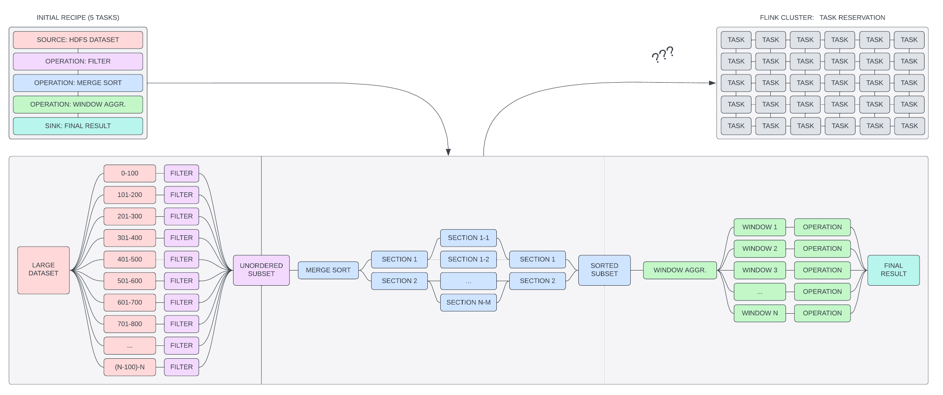
PIPELINE OPTIMIZATION
BATCHING
USES ALL AVAILABLE RESOURCES
ONE STAGE PER TIME

Slide 33
MICROBATCHING

Slide 34
WHAT DOES IT MEAN?
MICROBATCHING
Some use-cases are extremely time sensitive.
Out-of-order data ruins the process.
What timestamp do we trust?
When a message arrives into the Kafka message queue?
The timestamp that is attached to the message?
No two devices are identically synchronized.
Even in a hypothetical scenario, over time, synced devices would start drifting unpredictably.
Addressing such temporal problems is complicated.
Forego true real-time processing for some form of microbatching.
Aggregate data for n seconds.
Then sort and process the batch in-order.
Custom solutions are very difficult to implement.
Flink “watermarking” solves this problem for us.

Slide 35
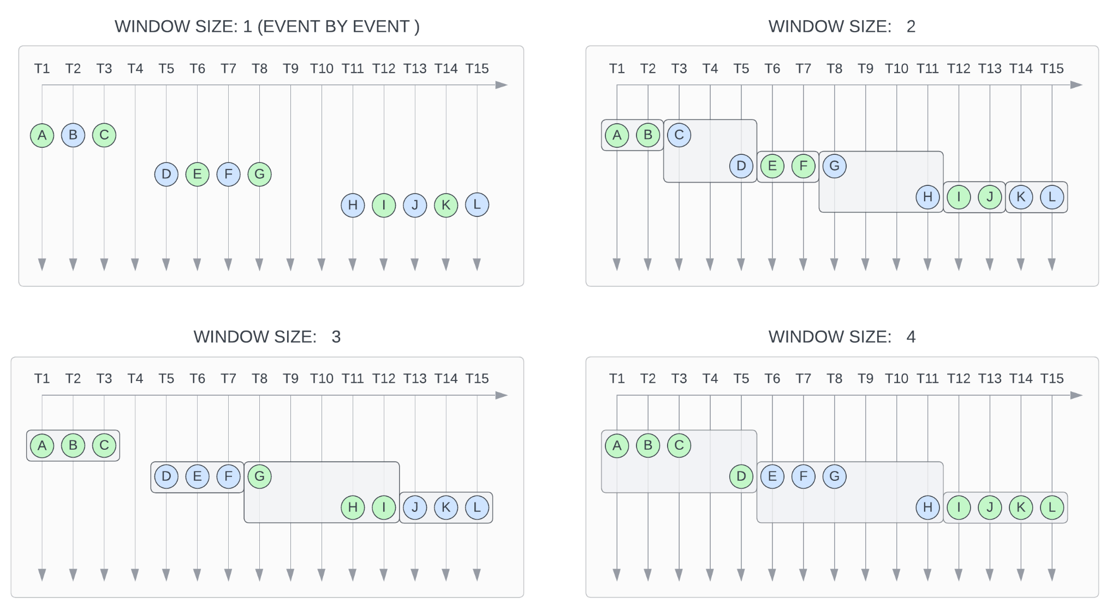
WINDOW BY COUNT
MICROBATCHING

Slide 36
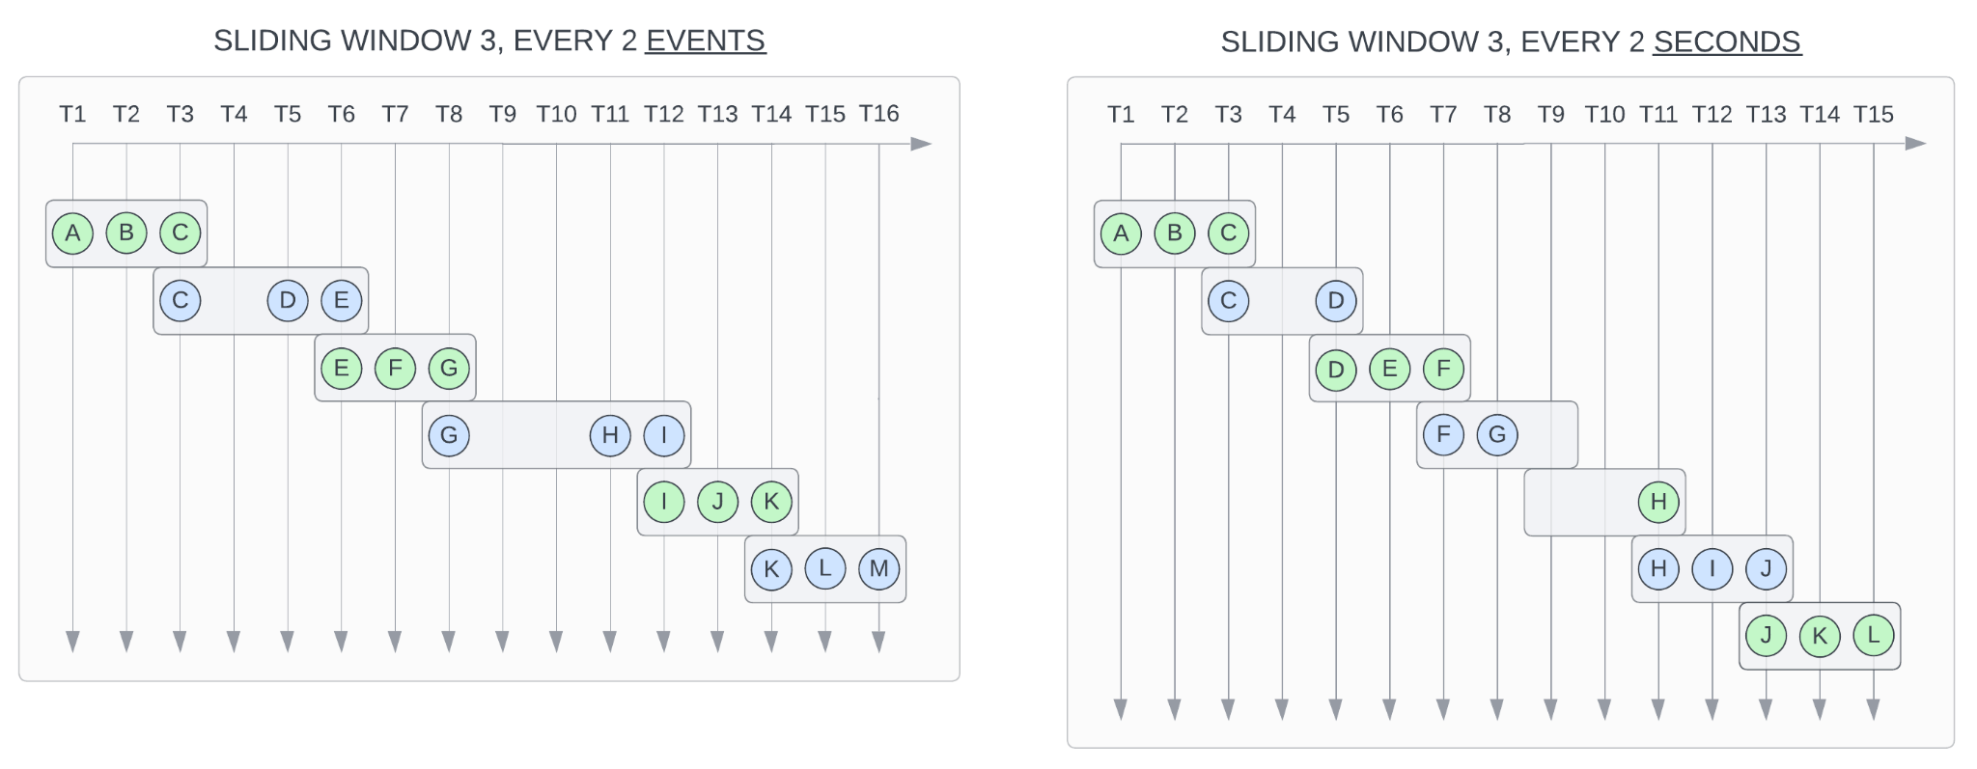
OVERLAPPING WINDOWS
MICROBATCHING

Slide 37
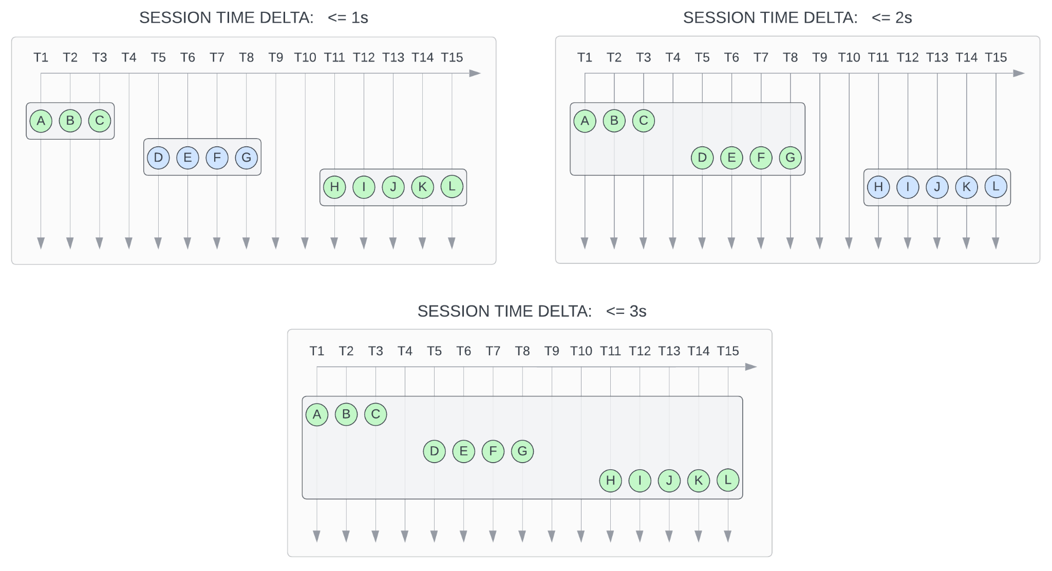
SESSION WINDOWS
MICROBATCHING

Slide 38
FLINK GUI

Slide 39
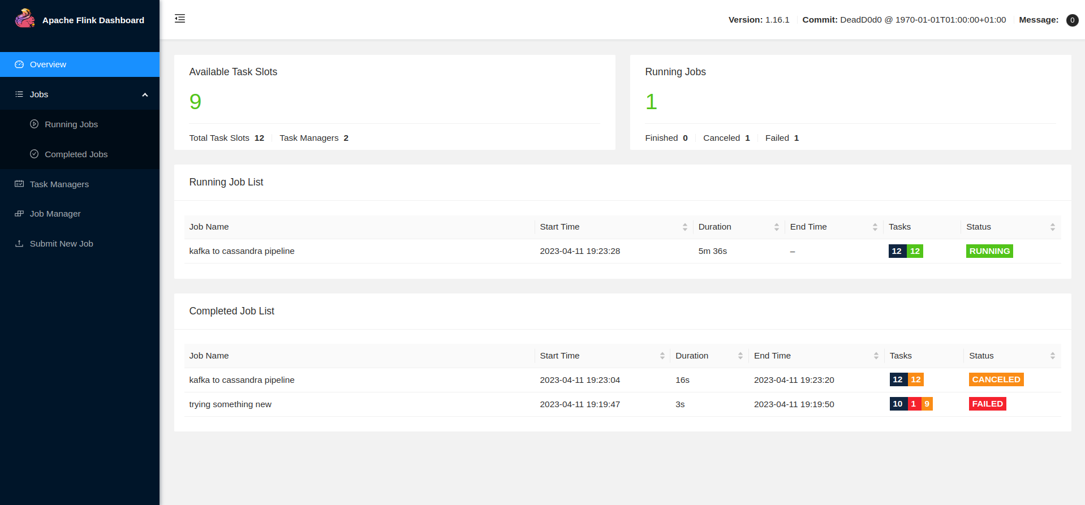
FLINK GUI

Slide 40
FLINK GUI

Slide 41
FLINK GUI

Slide 42
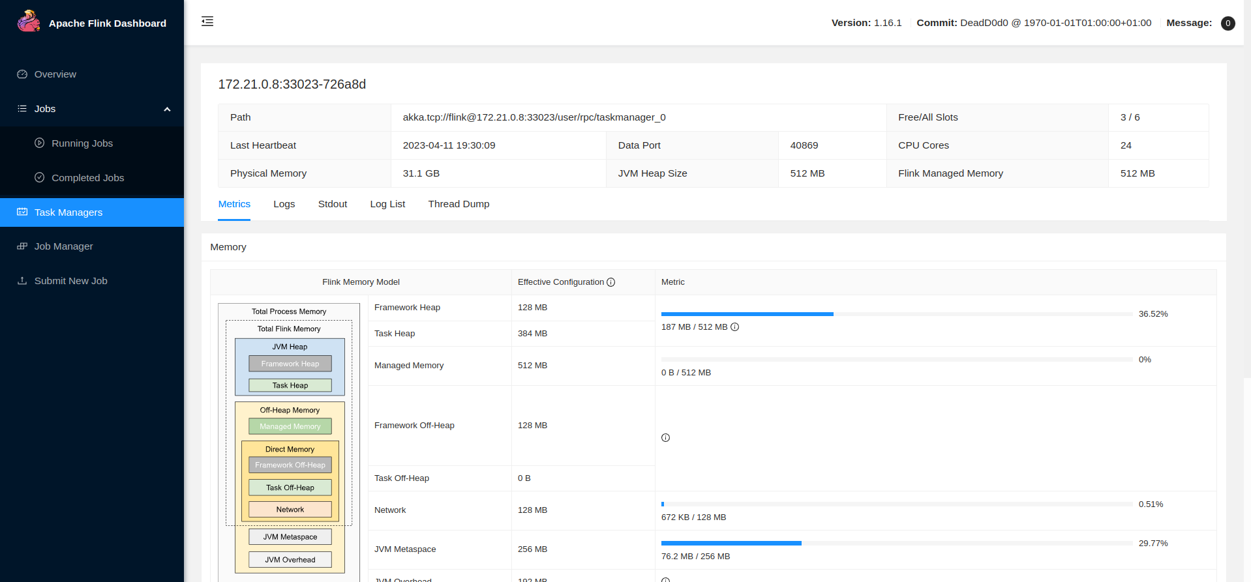
FLINK GUI

Slide 43
FLINK GUI

Slide 44
FLINK GUI

Slide 45
FLINK GUI

Slide 46
FLINK GUI

Slide 47
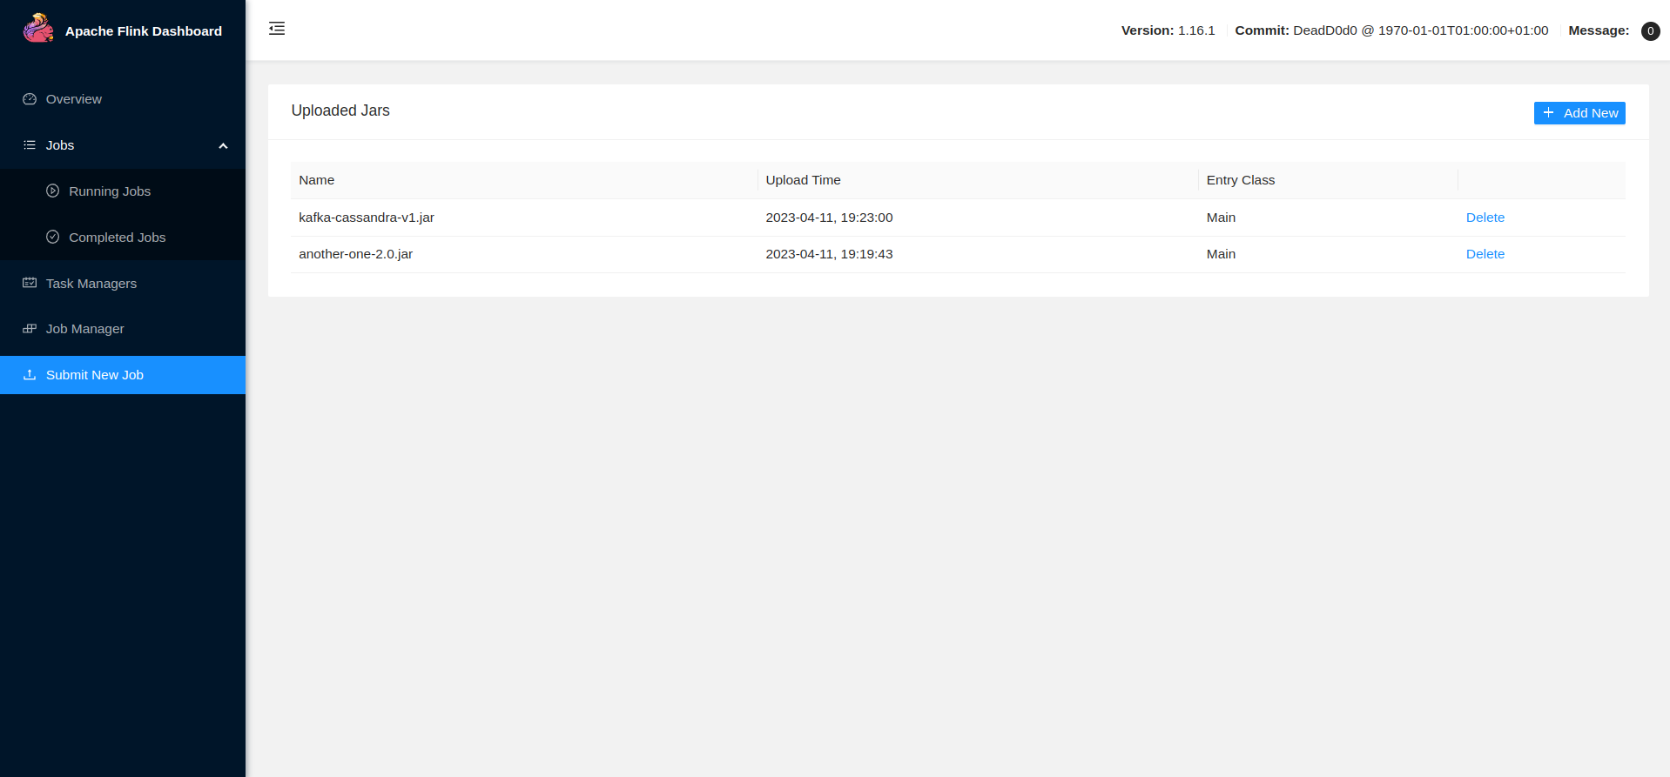
FLINK GUI

Slide 48
FLINK GUI

Slide 49
FLINK GUI

Slide 50
FLINK GUI

Slide 51
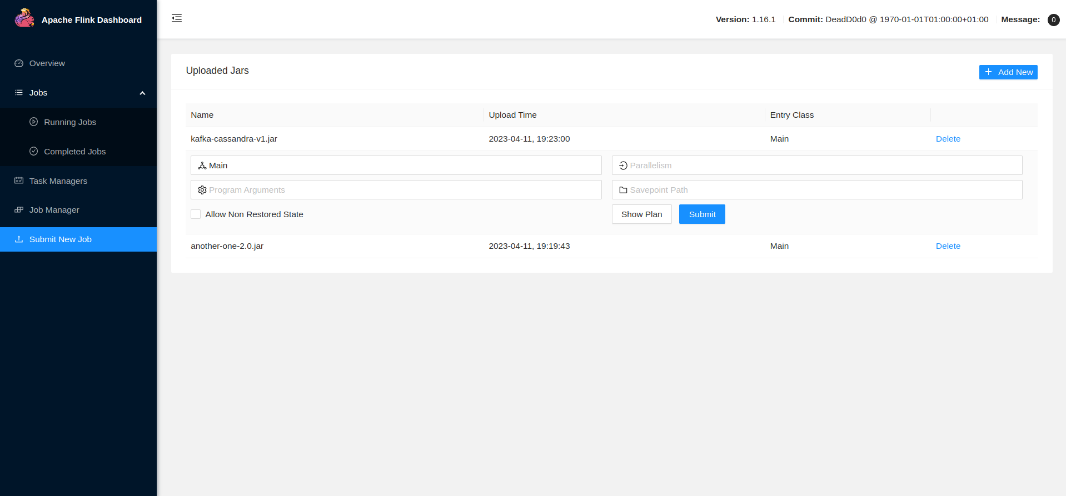
FLINK GUI

Slide 52
FLINK GUI

Slide 53
FLINK GUI

Slide 54
FLINK GUI

Slide 55
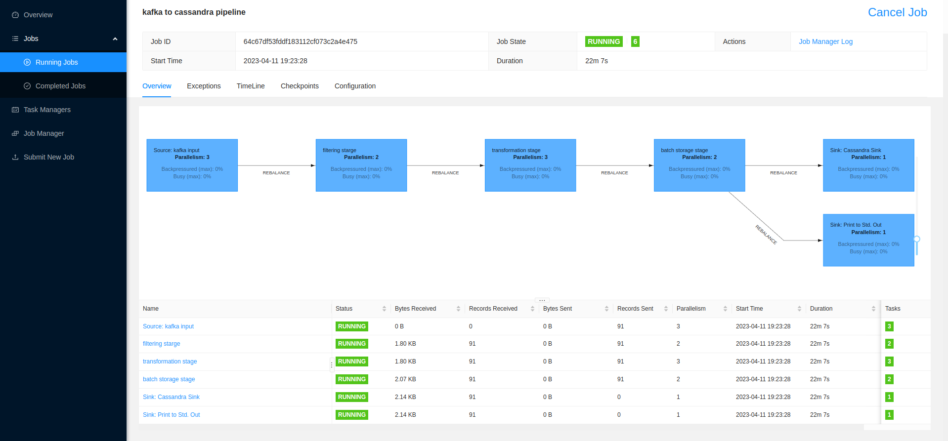
FLINK GUI

Slide 56
FLINK GUI

Slide 57
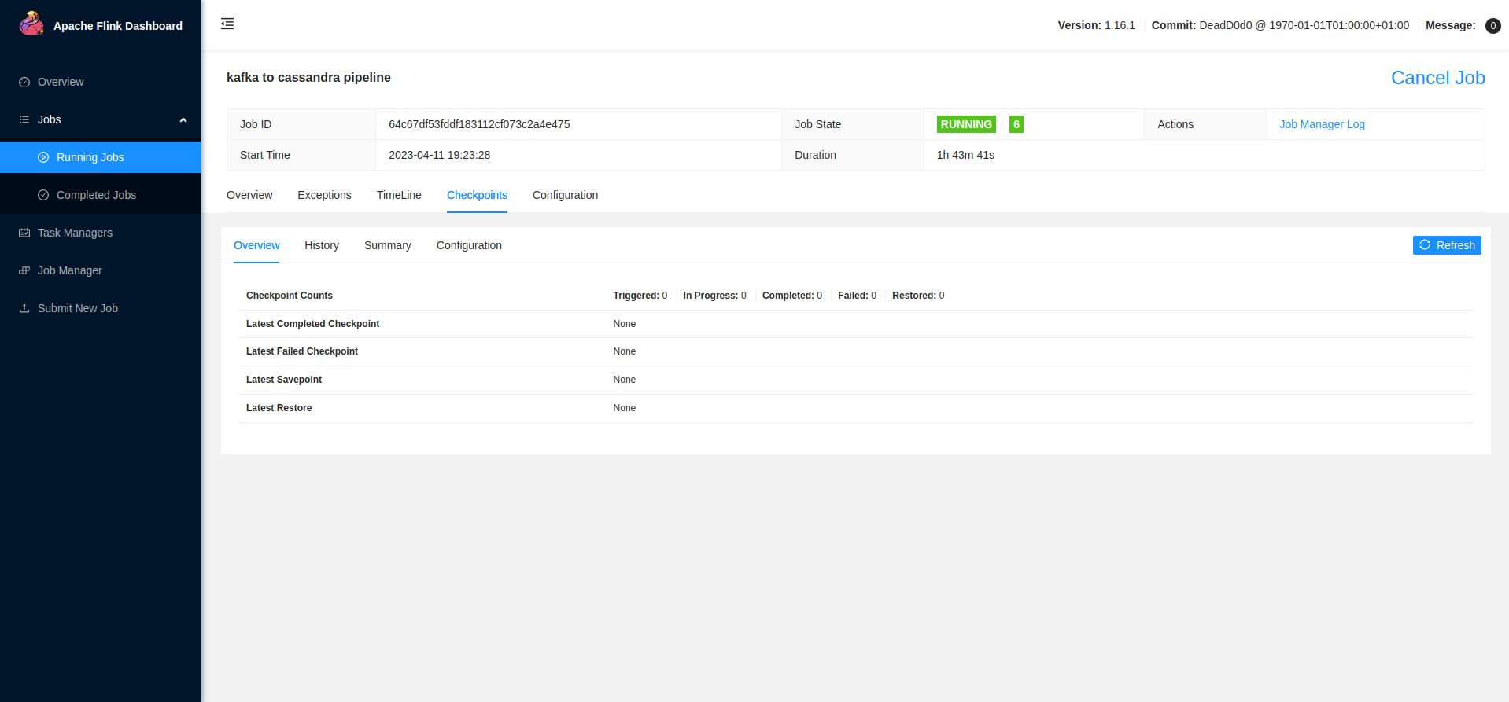
FLINK GUI

Slide 58
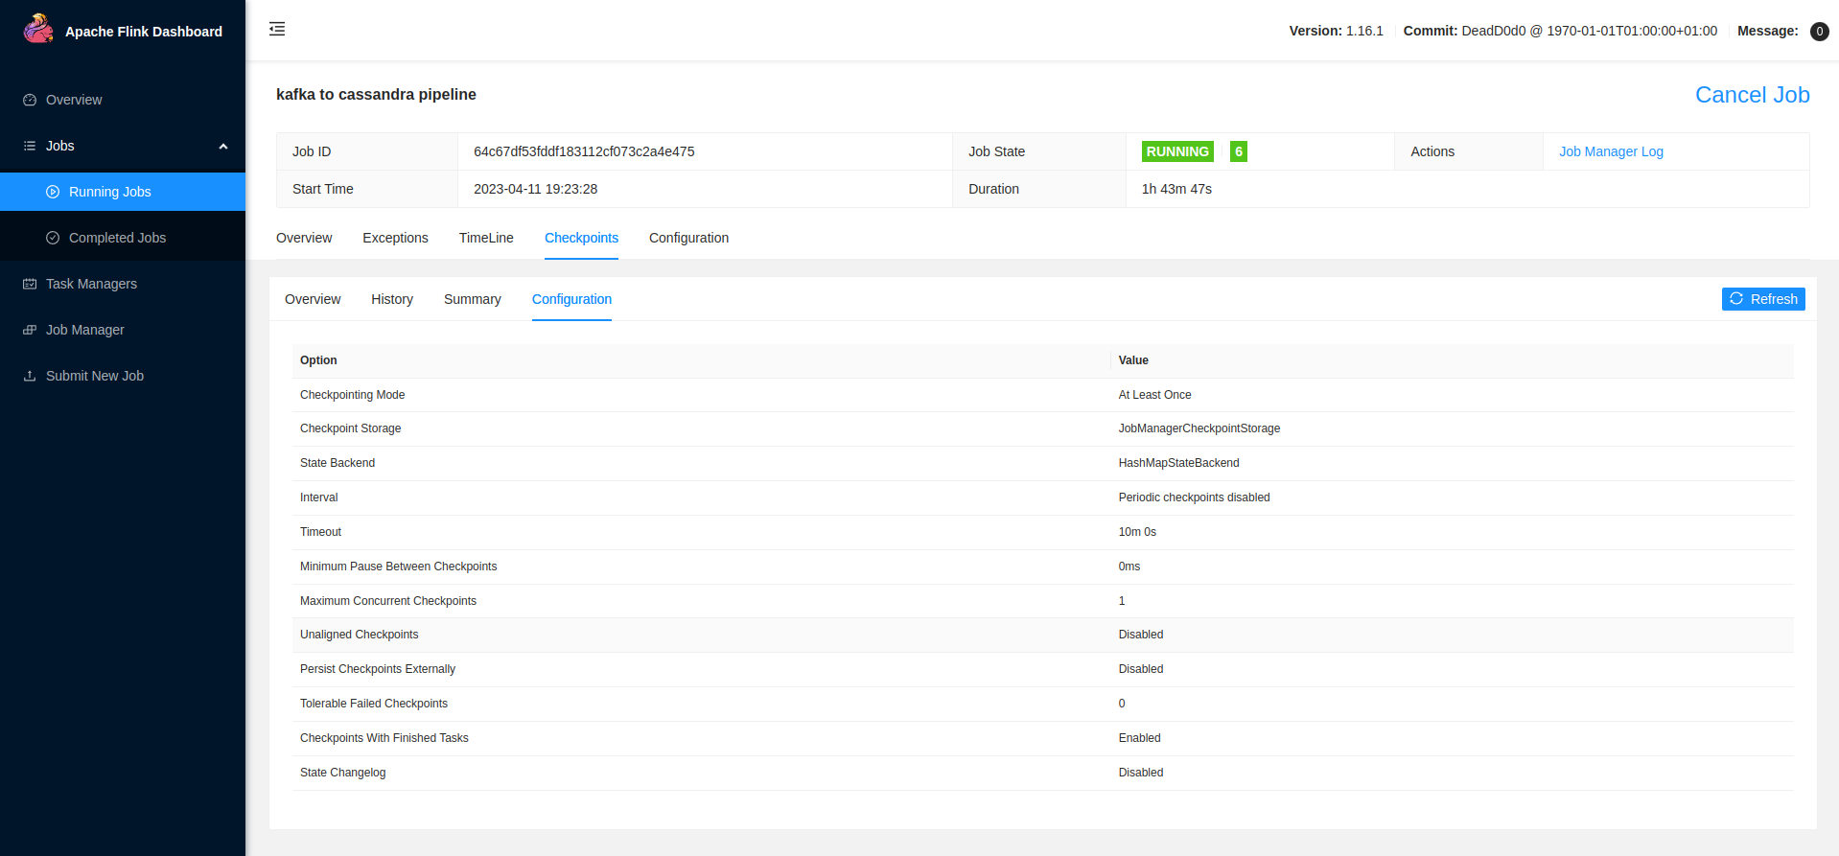
FLINK GUI

Slide 59
FLINK GUI

Slide 60
FLINK GUI

Slide 61
FLINK GUI

Slide 62
FLINK GUI

Slide 63
THE END
John Wickström
Aalto University, August 2024

